Slide 1
Basic Concepts
Course Code: CSC 2108
Course Title: Introduction To Database
Department of Computer Science
Faculty of Science and Technology
Lecture No: | 03 | Week No: | 02 | Semester: | TBA
Lecturer: | Name & email

Slide 2
Lecture Outline
Database Management System (DBMS)
Application of Database
Drawbacks of File System
View of Data
Level of Abstraction
Schema and Instance
Data Independence
Data Models
Database Languages: DML , DDL, SQL
Database Design
Storage Management
Database Users
Database Administrators

Slide 3
Database Management System(DBMS)
Contains information about a particular enterprise
Collection of interrelated data
Set of programs to access the data
An environment that is both convenient and efficient to use

Slide 4
Application of Database
Banking: all transactions
Airlines: reservations, schedules
Universities: registration, grades
Sales: customers, products, purchases
Manufacturing: production, inventory, orders, supply chain
Human resources: employee records, salaries, tax deductions

Slide 5
Drawbacks of Using File System for Data Storage
Data Redundancy and Inconsistency
Difficulty in Accessing Data
Data Isolation
Integrity Problems
Atomicity of updates
Concurrent access by multiple users
Security problems

Slide 6
Drawbacks of Using File Systems for Data Storage
Data Redundancy and Inconsistency
->Multiple file formats
->duplication of information in different files
Difficulty in Accessing Data
->Need to write a new program to carry out each new task
Data Isolation
-> Multiple files and formats
-> Difficult if we write different parts in different programming language.
Integrity Problems
->Integrity constraints/rule/condition (e.g. account balance > 0) become “buried” in program code rather than being stated explicitly
->Hard to add new constraints or change existing ones

Slide 7
Drawbacks of Using File Systems for Data Storage
Atomicity of updates
->Failures may leave database in an inconsistent state with partial updates carried out
Example: Transfer of funds from one account to another should either complete or not happen at all
Concurrent access by multiple users
->Concurrent accessed needed for performance
->Uncontrolled concurrent accesses can lead to inconsistencies
Example: Two people reading a balance and updating it at the same time
Security problems
->Hard to provide user access to some, but not all, data

Slide 8
View of Data
Database system is a collection of interrelated data and a set of programs to access and modify these data
Major purpose of a database system is to provide users with an abstract view of the data
The system hides certain details of how data are stored and maintained

Slide 9
Levels of Abstraction
Physical Level
Logical Level
View Level

Slide 10
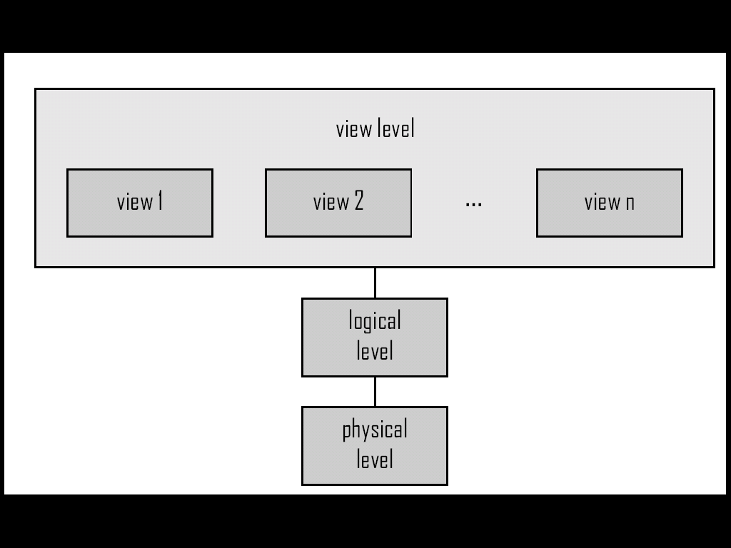
Levels of Abstraction
An architecture for a database system

Slide 11
Levels of Abstraction
Since many database-system users
are not computer trained,
developers hide the complexity from
users through several levels of
abstraction, to simplify users
interaction with the system.
Physical level:
Lowest level
describes how a record (e.g., customer) is stored
Complex low level data structures
Logical level:
Next higher level
describes what data are stored in database, and the relationships among the data
View level:
application programs hide details of data types
Views can also hide information (such as an employee’s salary) for security purposes

Slide 12
Schema and Instance
Schema – the logical structure of the database
Example: The database consists of information about a set of customers and accounts and the relationship between them
Analogous to type information of a variable in a program
Physical schema: database design at the physical level
Logical schema: database design at the logical level
Instance – the actual content of the database at a particular point in time
Analogous to the value of a variable

Slide 13
Data Independence
Physical Data Independence – the ability to modify the physical schema without changing the logical schema
Applications depend on the logical schema
In general, the interfaces between the various levels and components should be well defined so that changes in some parts do not seriously influence others
Logical Data Independence - the ability to modify the logical schema without causing application programs to be rewritten.
Required when the logical structure has been altered

Slide 14
Data Models
A collection of tools for describing
Data
Data relationships
Data semantics
Data constraints

Slide 15
Data Models
Relational Model , ER Model and Other Data Models
The relational model uses a collection of tables to represent both data and the relationships among those data.
The E-R data model is based on a perception of a real world that consists of a collection of basic objects, called entities and of relationships among these objects.
Object-based data models (Object-oriented and Object-relational)
Semi-structured data model (XML)
Other older models:
Network model
Hierarchical model

Slide 16
Database Language
DML
Stands for Data Manipulation Language
DML OPERATIONS: INSERT, UPDATE, DELETE, MERGE
Language for accessing and manipulating the data organized by the appropriate data model
DML also known as query language
Type of access are:
Retrieval of information stored in the database
Inserting of new information into the database
Deletion of information from the database
Modification of information stored in the database

Slide 17
Database Language
DDL
Stands for Data Definition Language (DDL)
Data dictionary contains metadata (i.e. data about data)
DDL OPERATIONS: CREATE, ALTER, DROP, RENAME, TRUNCATE

Slide 18
Database Language
SQL
Widely used non-procedural language
SQL is used to communicate with a database

Slide 19
Database Design
Logical and Physical Design
The process of designing the general structure of the database:
Logical Design – Deciding on the database schema. Database design requires that we find a “good” collection of relation schemas.
Business decision – What attributes should we record in the database?
Computer Science decision – What relation schemas should we have and how should the attributes be distributed among the various relation schemas?
Physical Design – Deciding on the physical layout of the database

Slide 20
Storage Manager
Components
Storage manager is a program module that provides the interface between the low-level data stored in the database and the application programs and queries submitted to the system.
The storage manager is responsible to the following tasks:
Interaction with the file manager
Efficient storing, retrieving and updating of data
Components of Storage Manager
Authorization and integrity manager
Transaction manager
File manager
Buffer manager

Slide 21
Storage Manager
Authorization and Integrity Manager: Checks the authority of users to access data.
Transaction manager: Ensure that the database in a consistent state despite system failures, and that concurrent transaction execution proceed without conflicting.
File manager : Manage allocation of space on disk storage and the data structures used to represent information stored on disk.
Buffer manager : Responsible for fetching data from disk storage into main memory and decide what data to cache in main memory. The data buffer manager is a critical part of the database system, since it enables the database handle data sizes that are much larger than the size of main memory.

Slide 22
Storage Manager
Data Structure
The storage manager implements several data structure as part of the physical system implementation
Data files: Store the database itself.
Data dictionary : stores metadata about the structure of the database, in particular the schema of the database.
Indices: Provide first access to the data items. Like index of the textbook.

Slide 23
Database Users
Types
Users are differentiated by the way they expect to interact with the system
Application programmers
Sophisticated users
Specialized users
Naive users

Slide 24
Database Users
Specialized users
One type of sophisticated user
Write specialized database applications that do not fit into the traditional data processing framework (expert system, knowledge base, graphics data, audio data)
Naive users
Invoke one of the permanent application programs that have been written previously
Read reports
Examples, people accessing database over the web, bank tellers,
Users are differentiated by the way they expect to interact with the system
Application programmers
Computer professionals who write application programs
Can use RAD tools for constructing forms and reports with minimal programming efforts.
Sophisticated users
Interact with the system without writing programs
Form requests in a database query language
Submit query to the query processor
Analyst

Slide 25
Database Administrator
Duties
Coordinates all the activities of the database system; the database administrator has a good understanding of the enterprise’s information resources and needs.
Database administrator's duties include:
Schema definition : The DBA create the original database schema by executing a set of data definition statements in the DDL
Storage structure and access method definition
Schema and physical organization modification
Granting user authority to access the database
Specifying integrity constraints
Acting as liaison with users
Monitoring performance and responding to changes in requirements

Slide 26
Books
Modern Database Management (Sixth Edition) by Fred R. McFadden, Jeffrey A. Hoffer, Mary B. Prescott
Database System Concepts (Fifth Edition) by Henry F. Korth, S. Sudarshan, A. Silberschatz
Oracle-database-10g-sql-fundamentals-1-student-guide-volume-1
SQL and Relational Theory: How to Write Accurate SQL Code by C.J. Date
Database Systems: A Practical Approach to Design, Implementation and Management (4th Edition) by Thomas M. Connolly, Carolyn E. Begg
Fundamentals of Database Systems, 5th Edition by RamezElmasri, Shamkant B. Navathe
Database Design and Relational Theory: Normal Forms and All That Jazz by C. J. Date
An Introduction to Database Systems 8th Edition, by C.J. Date

Slide 27
References
https://www.db-book.com/db6/slide-dir/index.html
https://docs.oracle.com/en/database/oracle/oracle-database/20/sqlrf/SQL-Standards.html#GUID-BCCCFF75-D2A4-43AD-8CAF-C3C97D92AC63
https://www.slideshare.net/HaaMeemMohiyuddin1/data-knowledge-and-information
https://www.slideshare.net/tabinhasan/from-data-to-wisdom
https://www.slideshare.net/thinnaphat.bo/

